Slide 1
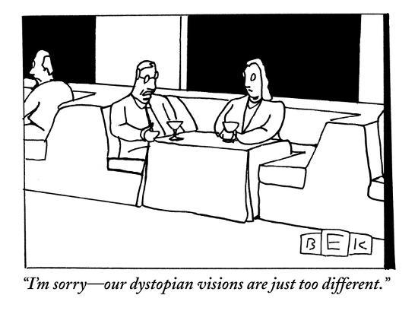
INFO215: Week 5b
Technological Utopias & Dystopias
https://www.newyorker.com/magazine/2011/05/09/queen-jane-approximately

Slide 2
technological determinism
technology
society
Technological determinism: an early 20th century idea that changes in technology cause changes in human social relations and organizational structures.

Slide 3
Hard technological determinism: cell phones will lead to the end of face-to-face human communication.
Soft technological determinism: cell phones will contribute to the end of face-to-face human communication.

Slide 4
mutual interdependence
technology
society
Technological determinism came before the concept of mutual interdependence.

Slide 5
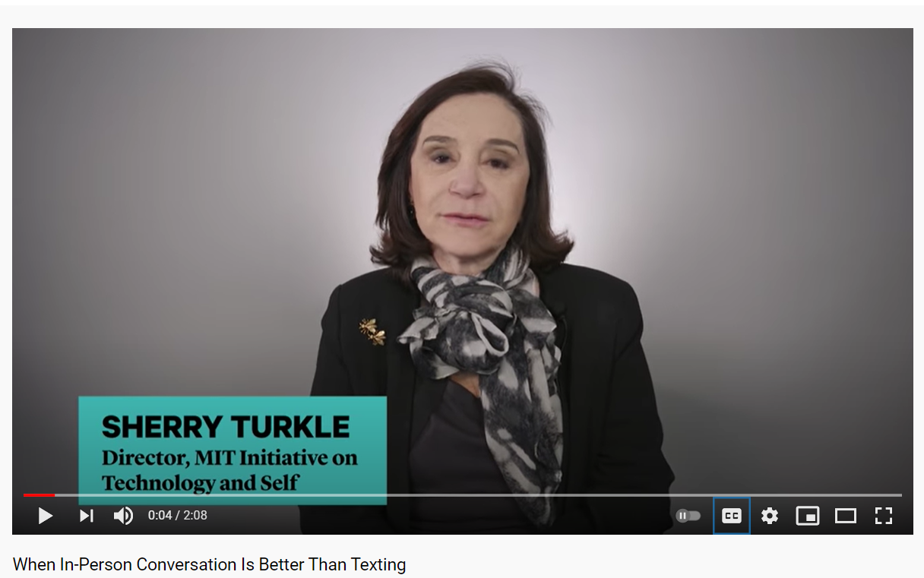
Utopia or Dystopia: Smartphones & Social Skills
https://www.youtube.com/watch?v=McR7eohL5h4

Slide 6
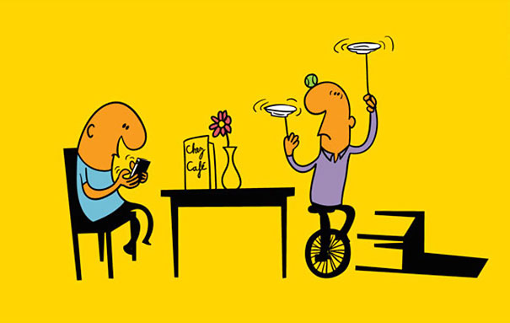
Utopia or Dystopia: Smartphones & Social Skills – What do you think?
Small-group discussion, step 1: List 5 ways that smartphones negatively impact how we communicate.

Slide 7
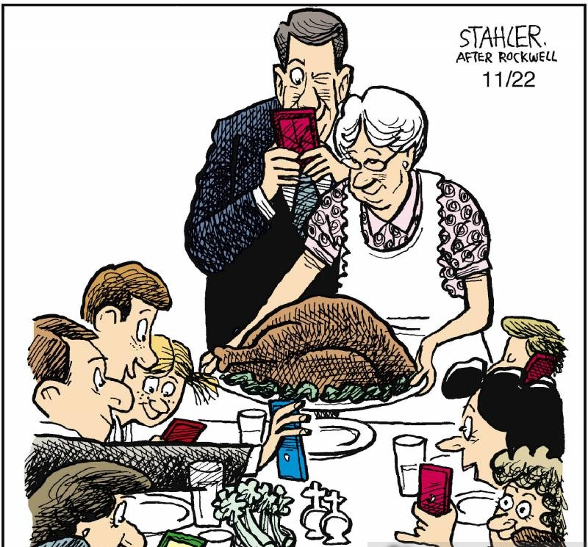
Utopia or Dystopia: Smartphones & Social Skills – What do you think?
Small-group discussion, step 2: List 5 ways that smartphones positively impact how we communicate.

Slide 8
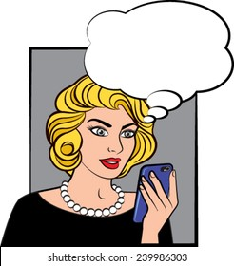
Utopia or Dystopia: Smartphones & Social Skills – What do you think?
Small-group discussion, step 3: Is the overall impact of smartphones on human communication:
Very positive
Somewhat positive
Neutral
Somewhat negative
Very negative
Are you good or are you evil?

